Slide 1

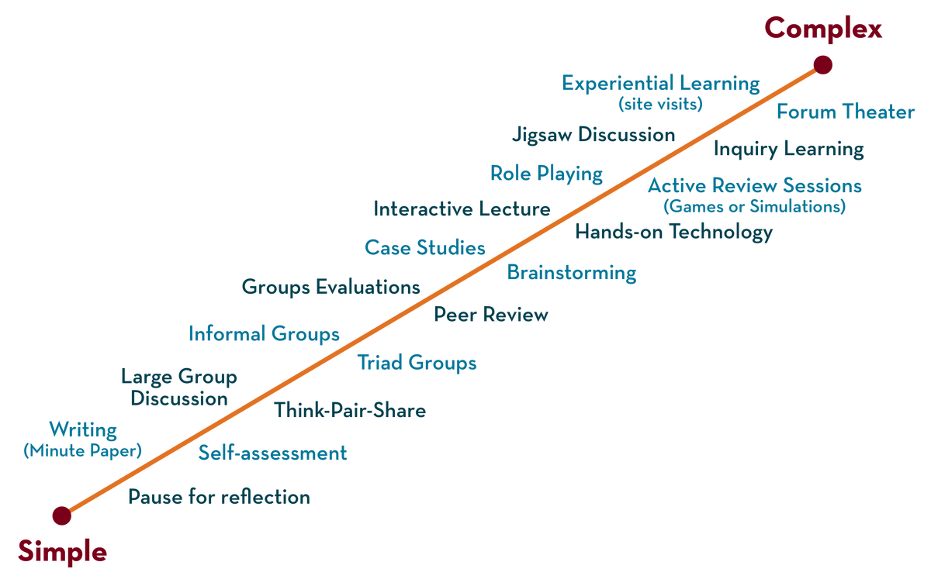
Department of CSE
Deep Learning
20CS3269AA
Topic:
ADAM FUNCTION
Session - 9

Slide 2



AIM OF THE SESSION
To familiarize students with the concept of Adam optimization
INSTRUCTIONAL OBJECTIVES
This Session is designed to:
Adam optimization
Discuss Challenges in Neural Network Optimization
LEARNING OUTCOMES
At the end of this session, you should be able to:
Able to understand loss functions and challenges in optimization

Slide 3
Index
The topics covered in the session are
ADA grade
Adam optimization

Slide 4
Adagrad (Adaptive Gradient Algorithm)
In the SGD with momentum algorithm , the learning rate remains constant.
In Adagrad optimizer, there is no momentum concept so, it is much simpler compared to SGD with momentum.
The idea behind Adagrad is to use different learning rates for each parameter base on iteration.
The reason for different learning rates :
is that the learning rate for sparse features parameters needs to be higher compare to the dense features parameter because the frequency of occurrence of sparse features is lower.

Slide 5
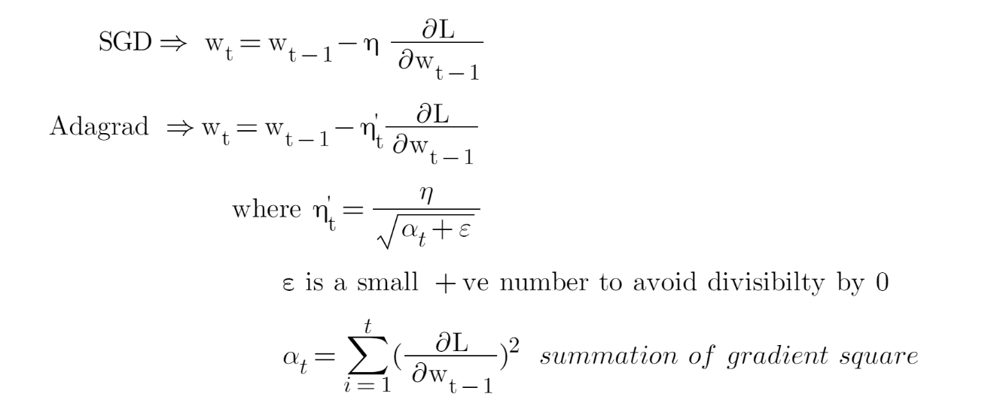
AGD vs ADAgrad

Slide 6
ADAM Algorithm
Adam full form is adaptive moment estimation,
It combines the advantages of SGD and RMSprop.
This optimization algorithm is a further extension of stochasticgradient descent to update network weights during training.
Unlike maintaining a single learning rate through training in SGD,Adam optimizer updates the learning rate for each network weight individually
It uses moving averages of the gradients to automatically tune the learning rate, which can make it more efficient and easier to use than SGD.

Slide 7
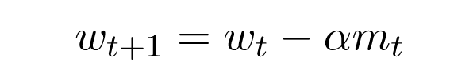
Working of adam optimizer
Where m_{t} is
. This algorithm is used to accelerate the gradient descent algorithm by taking into consideration the ‘exponentially weighted average’ of the gradients.
Using averages makes the algorithm converge towards the minima in a faster pace.
Parameters Used :
1. ϵ = a small +ve constant to avoid 'division by 0' error when (vt -> 0). (10-8)
2. β1 & β2 = decay rates of average of gradients in the above two methods. (β1 = 0.9 & β2 = 0.999)
3. α — Step size parameter / learning rate (0.001) .

Slide 8
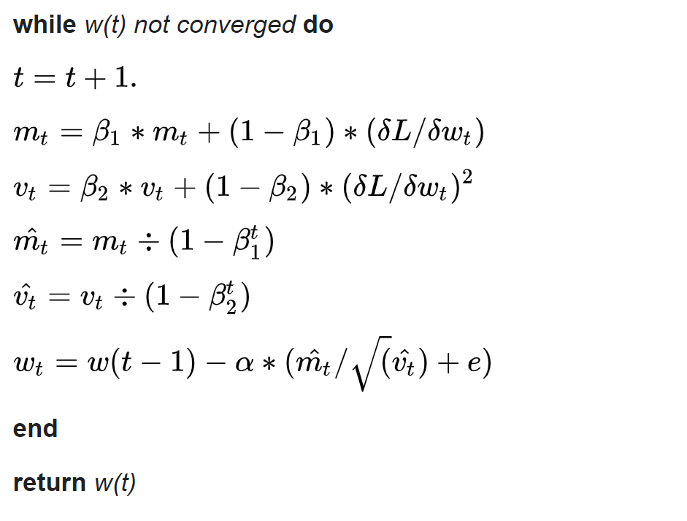
Pseudo code for adam optimizer

Slide 9
Adam Configuration Parameters
alpha. Also referred to as the learning rate or step size. The proportion that weights are updated (e.g. 0.001). Larger values (e.g. 0.3) results in faster initial learning before the rate is updated. Smaller values (e.g. 1.0E-5) slow learning right down during training
beta1. The exponential decay rate for the first moment estimates (e.g. 0.9).
beta2. The exponential decay rate for the second-moment estimates (e.g. 0.999). This value should be set close to 1.0 on problems with a sparse gradient (e.g. NLP and computer vision problems).
epsilon. Is a very small number to prevent any division by zero in the implementation (e.g. 10E-8)

Slide 10
ADAM advantages
Straightforward to implement
Computationally efficient
Little memory requirements
Appropriate for problems with very noisy/or sparse gradients
Hyper-parameters have intuitive interpretation and typically require a little tuning

Slide 11
Adagrad (Adaptive Gradient Algorithm)
In the SGD with momentum algorithm , the learning rate remains constant.
In Adagrad optimizer, there is no momentum concept so, it is much simpler compared to SGD with momentum.
The idea behind Adagrad is to use different learning rates for each parameter base on iteration.
The reason for different learning rates :
is that the learning rate for sparse features parameters needs to be higher compare to the dense features parameter because the frequency of occurrence of sparse features is lower.

Slide 12
SELF-ASSESSMENT QUESTIONS
1. T/F. Adam should be used with batch gradient computations, not with mini-batches.
False
Q. 2
Which of the following statements about Adam is True?
A. The learning rate hyperparameter α in Adam usually needs to be tuned.
B. Adam should be used with batch gradient computations, not with mini-batches.
A

Slide 13
TERMINAL QUESTIONS
Write Adam optimization algorithm
Show that Adam is best compared to momentum based optimization algorithm.

Slide 14
REFERENCES FOR FURTHER LEARNING OF THE SESSION
Books:
1 Ian Goodfellow and Yoshua Bengio and Aaron Courville (2016) Deep Learning Book
Sites and Web links:
1. https://shanzhenren.github.io/csci-699-replnlp-2019fall/lectures/W4-L1-Training_DNNs_I.pdf

Slide 15
Resources
https://shanzhenren.github.io/csci-699-replnlp-2019fall/lectures/W4-L1-Training_DNNs_I.pdf

